Slide 1
Fundamentals of Software Engineering
LECTURE 7: REQUIREMENT ENGINEERING

Slide 2
Topics covered
Requirements engineering intro
How to write good requirements
Requirement's specification document
Requirements engineering processes
Elicitation
Analysis
Validation
Evolution

Slide 3
Requirements Engineering
The process of establishing the services that the customer requires from a system and the constraints under which it operates and is developed
The requirements themselves are the descriptions of the system services and constraints that are generated during the requirements engineering process

Slide 4
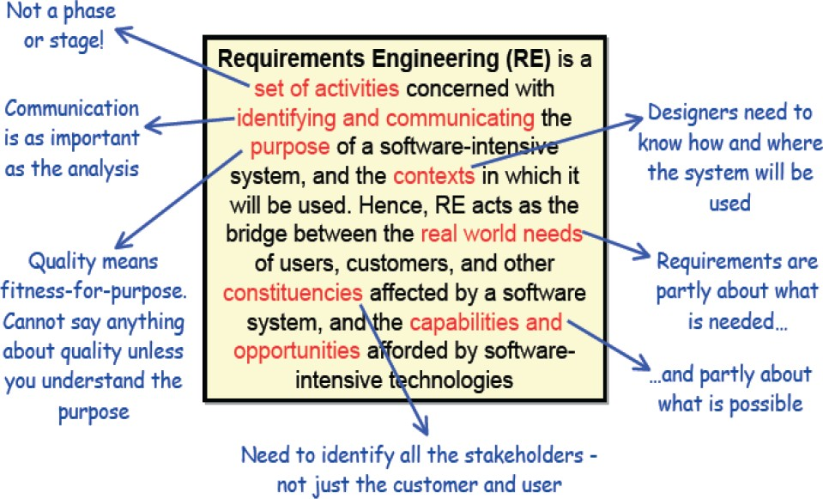
Definition of Requirement Engineering

Slide 5
Why we need
RE?

Slide 6
Types of requirement
User requirements
Statements in natural language plus diagrams of the services the system
provides and its operational constraints. Written for customers.
System requirements
A structured document setting out detailed descriptions of the system’s functions, services and operational constraints. Defines what should be implemented so may be part of a contract between client and contractor.

Slide 7
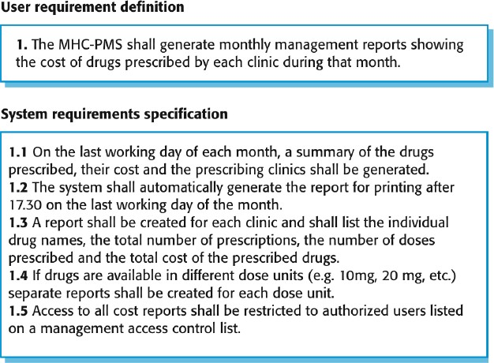
User and system requirements

Slide 8
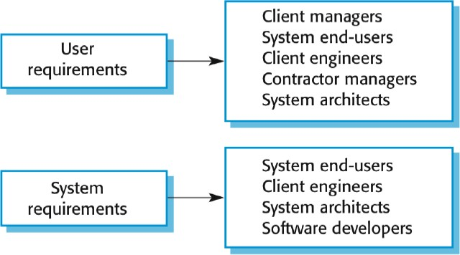
Readers of different types of requirements specification

Slide 9
Functional and nonfunctional requirements
Functional requirements
Statements of services the system should provide, how the system should react to particular inputs and how the system should behave in particular situations
May state what the system should not do
Non functional requirements
Constraints on the services or functions offered by the system such as timing constraints, constraints on the development process, standards, etc.
Often apply to the system as a whole rather than individual features or services
Domain requirements
Constraints on the system from the domain of operation

Slide 10
Functional requirements
Describe functionality or system services
Depend on the type of software, expected users and the type of system where the software is used
Functional user requirements may be high level statements of what the system should do
Functional system requirements should describe the system services in detail

Slide 11
Functional requirements for the MHC PMS
A user shall be able to search the appointments lists for all clinics
The system shall generate each day, for each clinic, a list of patients who are expected to attend appointments that day
Each staff member using the system shall be uniquely identified by his or her 8 digit employee number

Slide 12
Non functional requirements
These define system properties and constraints e.g. reliability, response time, and storage requirements. Constraints are I/O device capability, system representations, etc.
Process requirements may also be specified mandating a particular IDE, programming language or development method.
Non functional requirements may be more critical than functional requirements. If these are not met, the system may be useless.

Slide 13
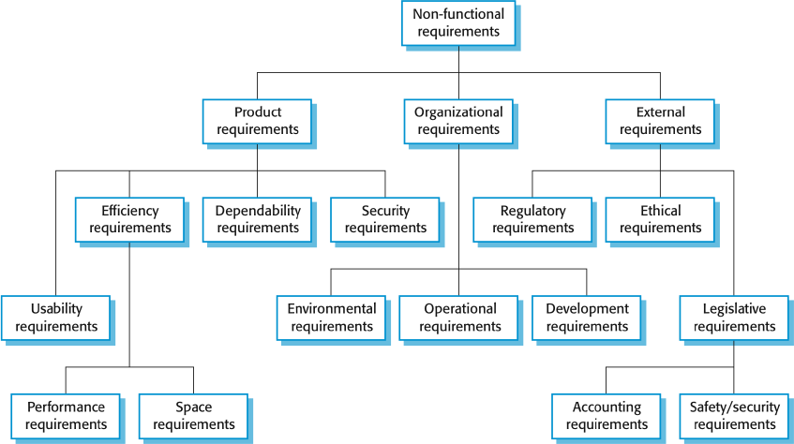
Types of nonfunctional requirement

Slide 14
Non functional requirements implementation
Non functional requirements may affect the overall architecture of a system rather than the individual components
For example, to ensure that performance requirements are met, you may
have to organize the system to minimize communications between
components
A single non functional requirement, such as a security requirement, may generate a number of related functional requirements that define system services that are required
It may also generate requirements that restrict existing requirements

Slide 15
Non functional classifications
Product requirements
Organizational
requirements
External requirements
Requirements which specify that the delivered product must behave in a particular way e.g. execution speed, reliability, etc.
Requirements which are a consequence of organizational policies and procedures e.g. process standards used, implementation requirements, etc.
Requirements which arise from factors which are external to the system and its development process,
e.g. interoperability requirements, legislative requirements, etc.

Slide 16
Product requirement
The MHC PMS shall be available to all clinics during normal working hours (Mon Fri, 0830 17.30). Downtime within normal working hours shall not exceed five seconds in any one day.
Organizational requirement
Users of the MHC PMS system shall authenticate themselves using their health authority identity card.
Examples of nonfunctional requirements in the MHC
PMS
External requirement
The system shall implement patient privacy provisions as set out in HStan 03 2006 priv.

Slide 17
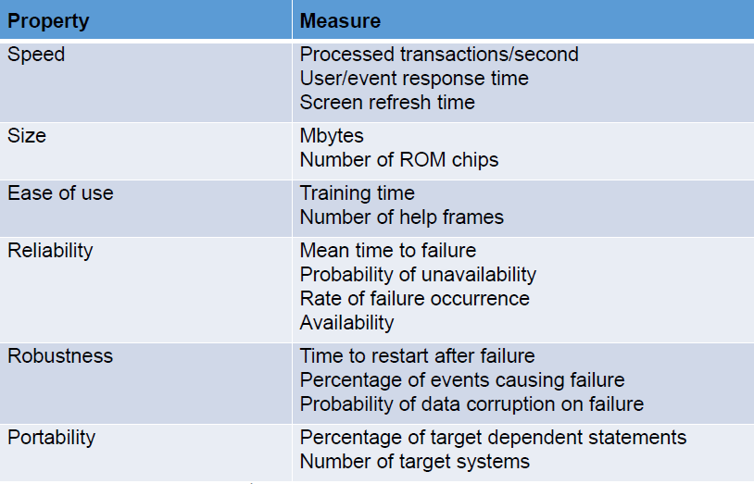
Metrics for specifying non functional requirements

Slide 18
How to write
GOOD REQUIREMENTS

Slide 19
Unambiguous
Testable (verifiable)
Clear (concise, terse, simple, precise)
Correct
Constraints of a Good requirement
Understandable
Feasible (realistic, possible)
Independent
Atomic
Necessary
Implementation free (abstract)

Slide 20
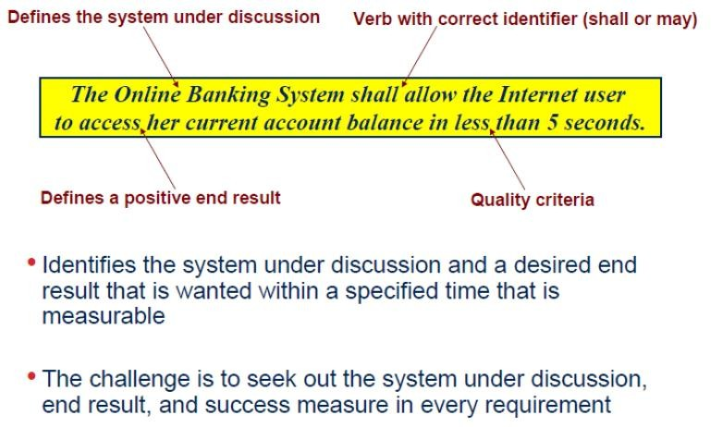
Writing a good requirement
20

Slide 21
Unambiguous
There should be only one way to interpret the requirement. Sometimes ambiguity is introduced by undefined
acronyms:
REQ1The system shall be implemented using ASP.
Does ASP mean Active Server Pages or Application Service Provider? To fix this, we can mention a full name and provide an acronym in parentheses:
REQ1The system shall be implemented using Active Server Pages (ASP).
Here’s another example:
REQ1The system shall not accept passwords longer than 15 characters.
It is not clear what the system is supposed to do:
The system shall not let the user enter more than 15 characters.
The system shall truncate the entered string to 15 characters.
The system shall display an error message if the user enters more than 15 characters.

Slide 22
Testable (Verifiable)
The system shall resist concurrent usage by many users.
What number should be considered “many”—10, 100, 1,000?
Some words can make a requirement untestable
Some adjectives: robust, safe, accurate, effective, efficient, expandable, flexible, maintainable, reliable, user-friendly, adequate
Some adverbs and adverbial phrases: quickly, safely, in a timely manner
Nonspecific words or acronyms: etc., and/or, TBD

Slide 23
Clear (Concise, Terse, Simple, Precise)
Requirements should not contain unnecessary verbiage or information. They
should be stated clearly and simply:
REQ1Sometimes the user will enter Airport Code, which the system will understand, but sometimes the closest city may replace it, so the user does not need to know what the airport code is, and it will still be understood by the system.
This sentence may be replaced by a simpler one:
REQ1The system shall identify the airport based on either an Airport Code or a City Name.

Slide 24
Correct
If a requirement contains facts, these facts should be true:
REQ1Car rental prices shall show all applicable taxes (including 6% state tax).
The tax depends on the state, so the provided 6% figure is incorrect.

Slide 25
Understandable
Requirements should be grammatically correct and written in a consistent style. Standard conventions should be used. The word “shall” should be used instead of “will,” “must,” or “may.”

Slide 26
Feasible (Realistic, Possible)
The requirement should be doable within existing constraints such as time, money, and available resources:
REQ1The system shall have a natural language interface that will understand commands given in English language.
This requirement may be not feasible within a short span of development time.

Slide 27
Independent
To understand the requirement, there should not be a need to know any other requirement:
REQ1The list of available flights shall include flight numbers, departure time, and arrival time for every leg of a flight.
REQ2It should be sorted by price.
The word “It” in the second sentence refers to the previous requirement. However, if the order of the requirements changes, this requirement will not be understandable.

Slide 28
Atomic
The requirement should contain a single traceable element:
REQ1The system shall provide the opportunity to book the flight, purchase a ticket, reserve a hotel room, reserve a car, and provide information about attractions.
This requirement combines five atomic requirements, which makes traceability very difficult. Sentences including the words “and” or “but” should be reviewed to see if they can be broken into atomic requirements.

Slide 29
Necessary
A requirement is unnecessary if None of the stakeholders needs the requirement. Or Removing the requirement will not affect the system.
An example of a requirement that is not needed by a stakeholder is a requirement that
is added by developers and designers
For example, the fact that a developer thinks that users would like a feature that displays a map of the airport and he knows how to implement it is not a valid reason to add this requirement.
An example of a requirement that can be removed because it does not provide any
new information might look like the following:
REQ1All requirements specified in the Vision document shall be implemented and tested.

Slide 30
Implementation free (Abstract)
Requirements should not contain unnecessary design and implementation information:
REQ1Content information shall be stored in a text file.
How the information is stored is transparent to the user and should
be the designer’s or architect’s decision.

Slide 31
Consistent
There should not be any conflicts between the requirements. Conflicts may be direct or indirect. Direct conflicts occur when, in the same situation, different behavior is expected:
REQ1Dates shall be displayed in the mm/dd/yyyy format.
REQ2Dates shall be displayed in the dd/mm/yyyy format.
REQ1For users in the U.S., dates shall be displayed in the mm/dd/yyyy format.
REQ2For users in France, dates shall be displayed in the dd/mm/yyyy format.

Slide 32
Nonredundant
Each requirement should be expressed only once and should not overlap with another requirement:
REQ1A calendar shall be available to help with entering the flight date.
REQ2The system shall display a pop-up calendar when entering any date.
The first requirement (related to only the flight date) is a subset of the second one (related to any date entered by the user).

Slide 33
Complete
A requirement should be specified for all conditions that can occur:
REQ1 A destination country does not need to be displayed for flights within the U.S.
REQ2 For overseas flights, the system shall display a destination country.
What about flights to Canada and Mexico? They are neither “within the U.S.” nor“overseas.”
All applicable requirements should be specified. This is the toughest condition to be checked. There is really no way to be sure that all the requirements are captured and that one week before the production date one of the stakeholders won’t say, “I forgot to mention that I need one more feature in the application.”

Slide 34
Conflicts
Conflicts between different nonfunctional requirements are common in
complex systems, Spacecraft system
–To minimize weight, the number of separate chips in the system should be minimized
–To minimize power consumption, lower power chips should be used
–However, using low power chips may mean that more chips have to be used. Which is the most critical requirement?

Slide 35


